Slide 1
IGGI Game Design Part II AI Informed Game Design
Simon Lucas and Diego Perez

Slide 2
AI Informed Game Design
How can AI be used to make better games?
What does better mean?
Set design objectives in terms of player experience
Then try to meet them
Measure experience of a range of AI bots
Also run user trials
The course will be taught with a mixture of lectures, labs (including game AI competitions), group work
There are also seminars which should be attended (see schedule)

Slide 3
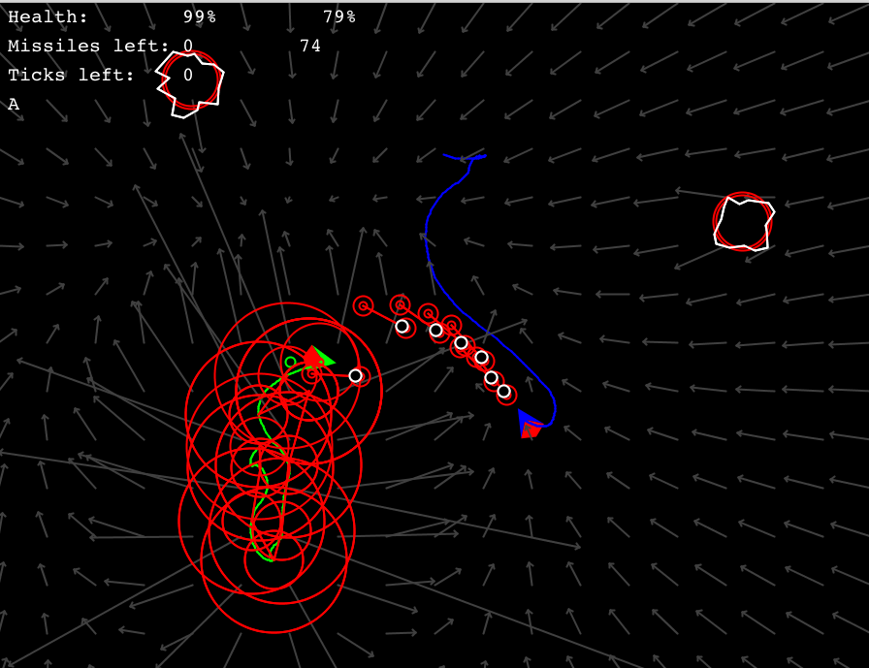
Example from 2015: “Battle Asteroids” (Thanks to IGGI Student: Memo Akten, Daniel Berio, Piers Williams, Joseph Walton-Rivers)
MCTS able to create reasonable agents for 2-player game
Sometimes with the silly assumptions about what the opponent will do!
Notes:
Example shows a mashup game taking Asteroids ships physics and rock-shooting, combined with snake or Tron style trail, and 2-player battle mode.

Slide 4
Main Topics
Game Design Spaces
Design, Implementation and Testing
Player Experience
And how to measure it
General Video Game AI and Video Game Description Language (VGDL)
General and easily applied AI Agent Algorithms
Mini AI Competitions
Game Mashups

Slide 5
Automated Game Design
An exciting topic in Game AI and in Computational Creativity
Can an algorithm automatically design novel high quality games, or game levels?
Or perhaps choose good parameters for an existing game?
Work in this area has been around for a while
But with better general purpose AI, is really starting to take off now!

Slide 6
Automated Game Design: Main Steps and Challenges
Main steps:
Creating a search space for a set of games (or game levels)
Creating operators to choose points in the space, and also variation operators to choose points in some neighbourhood (e.g. a Mutation operator)
Evaluate points in the search space
In general, the final step (evaluation) is the hardest!
For a restricted set of games, we can write evaluation heuristics
Or measure the experience of AI bots …

Slide 7
Using AI Bots for Play-Testing
Two challenges with the AI bots:
Providing bots which are smart enough (remember it’s easy to make a smart bot behave stupidly)
General Video Game AI (GVGAI) has already made good progress with this
But plenty more is possible
Interpreting the experience the bots have in a meaningful way.
Hard in general, but some notable successes

Slide 8
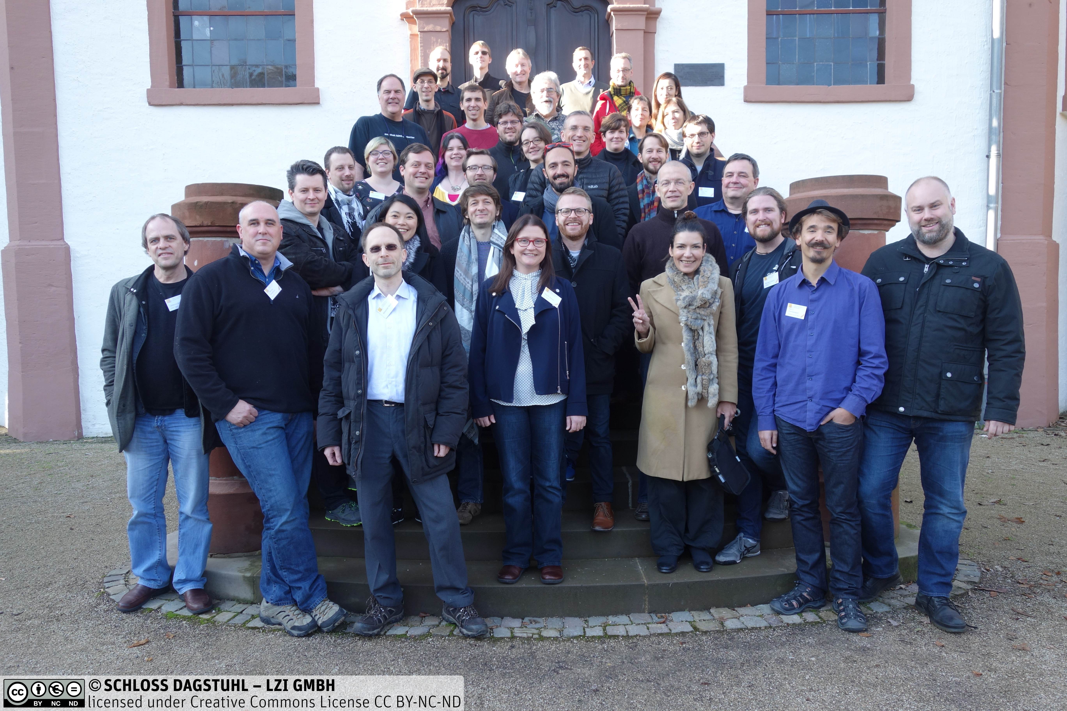
We’ll run it a bit like a Dagstuhl Seminar – Interesting challenges solved in groups

Slide 9
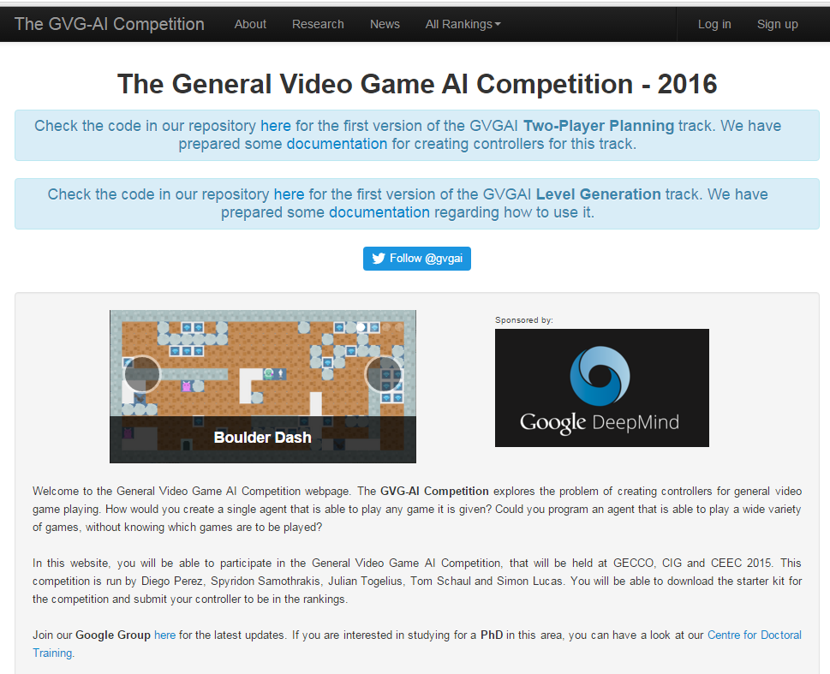
Can we find a sweet spot search space between numerical parameter tuning and VGDL?

Slide 10
Deliverables / Assessments
Report in the form of a short draft conference paper. The paper should include or be accompanied by a brief statement of the contribution of each author.
Peer-review comments on the paper (peer review is by course participants)
Code for two versions of a game drawn from a game design space
A video showing the games in action
Results of user trials, if any
Data (game logs etc) underlying the results in the paper
We encourage groups to revise their papers after the peer feedback and submit to a relevant conference or workshop

